Slide 1
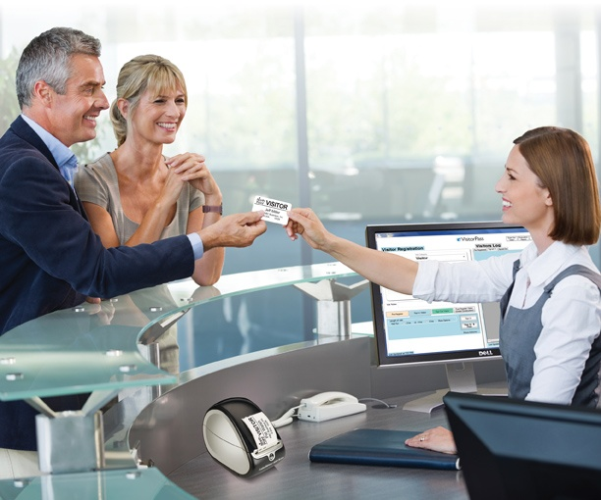

VISITOR MANAGEMENT SYSTEM

Slide 2
About the Institute
Techie’s Institute for Learning and Innovation
Techie's Institute is promoted by team of highly talented professionals who have combined I.T. and Corporate Training experience. Techie's Institute is different to other Institutes, in terms of its real-time and project based curriculum, industry-specific course content, state-of-art infrastructure. It is mainly known for its software training with more than 4 years of experience in the field of software development. TECHIE’S INSTITUTE FOR LEARNING AND INNOVATION has its fully independent programming, Designing and multimedia skill set.

Slide 3
Front End:PHP
PHP development began in 1995 when Rasmus Lerdorf wrote several Common Gateway Interface (CGI) programs in C, which he used to maintain his personal homepage. He extended them to work with web forms and to communicate with databases, and called this implementation "Personal Home Page/Forms Interpreter" or PHP/FI.
PHP/FI could be used to build simple, dynamic web applications. To accelerate bug reporting and improve the code, Lerdorf initially announced the release of PHP/FI as "Personal Home Page Tools (PHP Tools) version 1.0" on the Usenet discussion group comp. infosystems .www.authoring.cgi on June 8, 1995.

Slide 4
BackEnd:MySQL
MySQL is the world’s most widely used open-source relational database management system (RDBMS),and ships with no GUI tools to administer MySQL databases or manage data contained within the databases. Users may use the included command line tools, or use MySQL “front-ends”, desktop software and web applications that create and manage MySQL databases, build database structures, back up data,inspect status, and work with data records. The official set of MySQL front-end tools, MySQL Workbench is actively developed by Oracle, and is freely available for use.

Slide 5
What is Visitor Management System
Visitor Management System is Web software which is use to generate the passes for the visitors and for the labours . This software helps us to maintian the record of visitor visted to the company as well as to maintain the records of the labour ,vendor ,and contractor. which is made for the tourist ,Maintaining paper record is not possible so it is advance way to maintain both record as well integrity in security. This software can be used by schools ,colleges.

Slide 6
FEATURES OF VMS
• Create a strong database
• Helps in security
• New method of login
• Past records can be found easily
• Data integrity
• Easy to have client Data

Slide 7
Hardware Requirements
Processor
Intel(R) Core i3 CPU
Memory 4.00 GB
Free Disk Space 512 MB(including 200 … for DBMS)
Display 800*600 colors(1024*768 High color-16 bit Recommended)

Slide 8
Software Requirements
Operating System Windows 7
Client Side System HTML5,CSS
Programming Language PHP

Slide 9
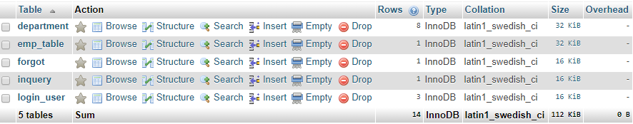
DATABASE
Project Tables
Department Table

Slide 10
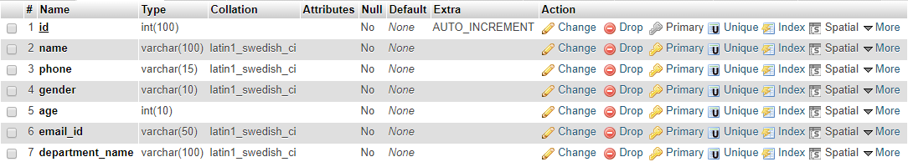
Employee Table
Forgot Table

Slide 11
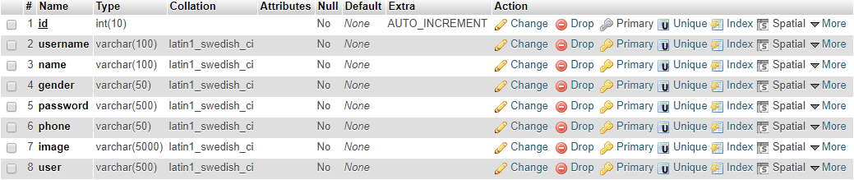
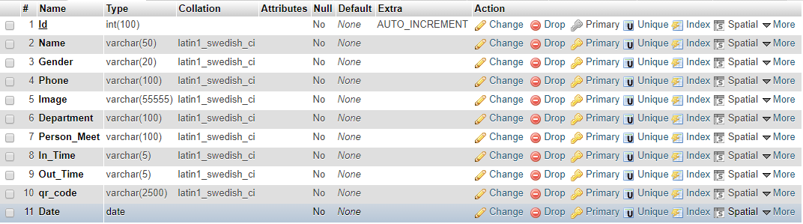
Login Table
Inquiry Table

Slide 12
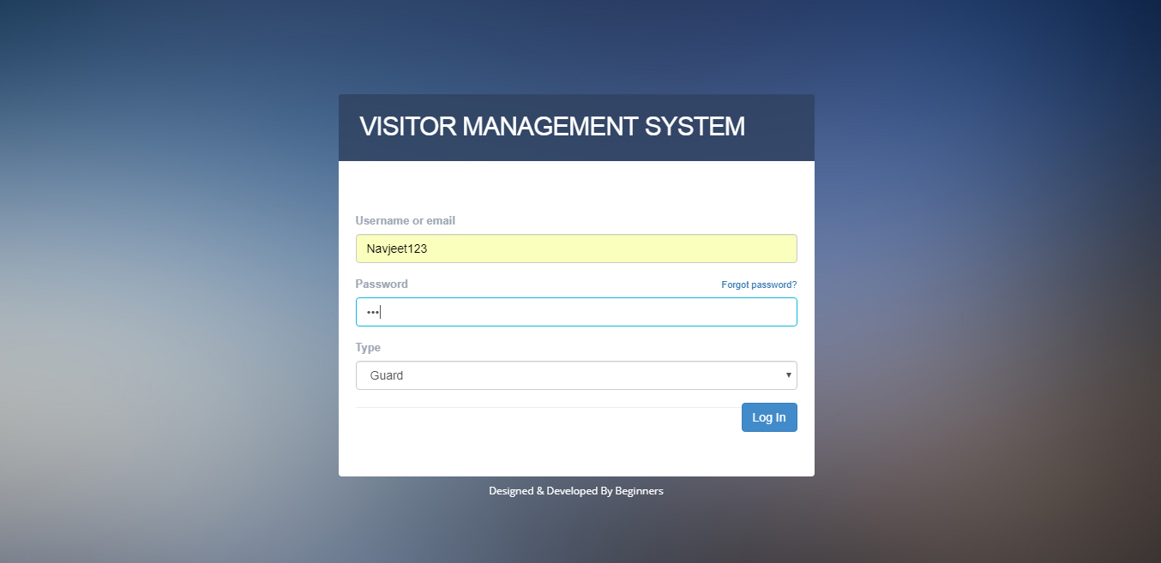
SNAPSHOTS
Login Page: This page is the first page which ask for the username and password of the user . If the username exist in the database then it will give you the access of the software otherwise it will prompt an error .
The logins exist of two types :-
1. Admin/Head of Department Login
2. Security Login ( Each guard has his personal login )

Slide 13
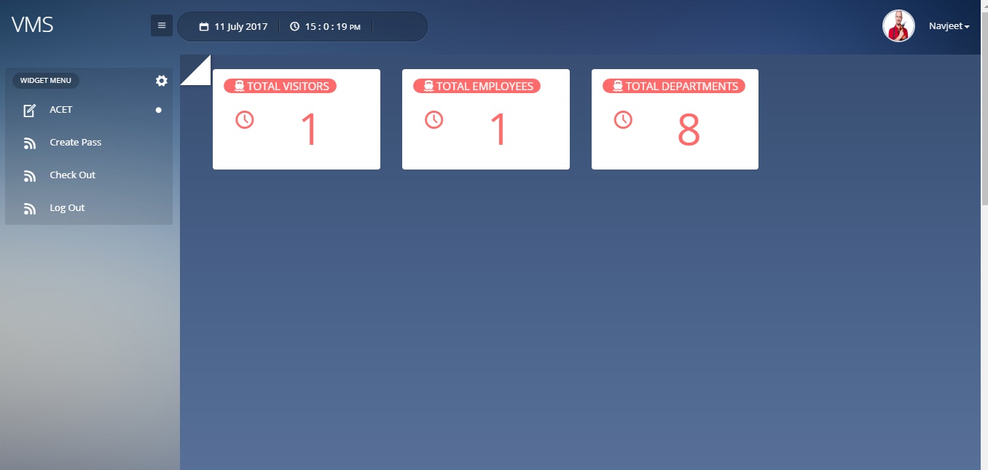
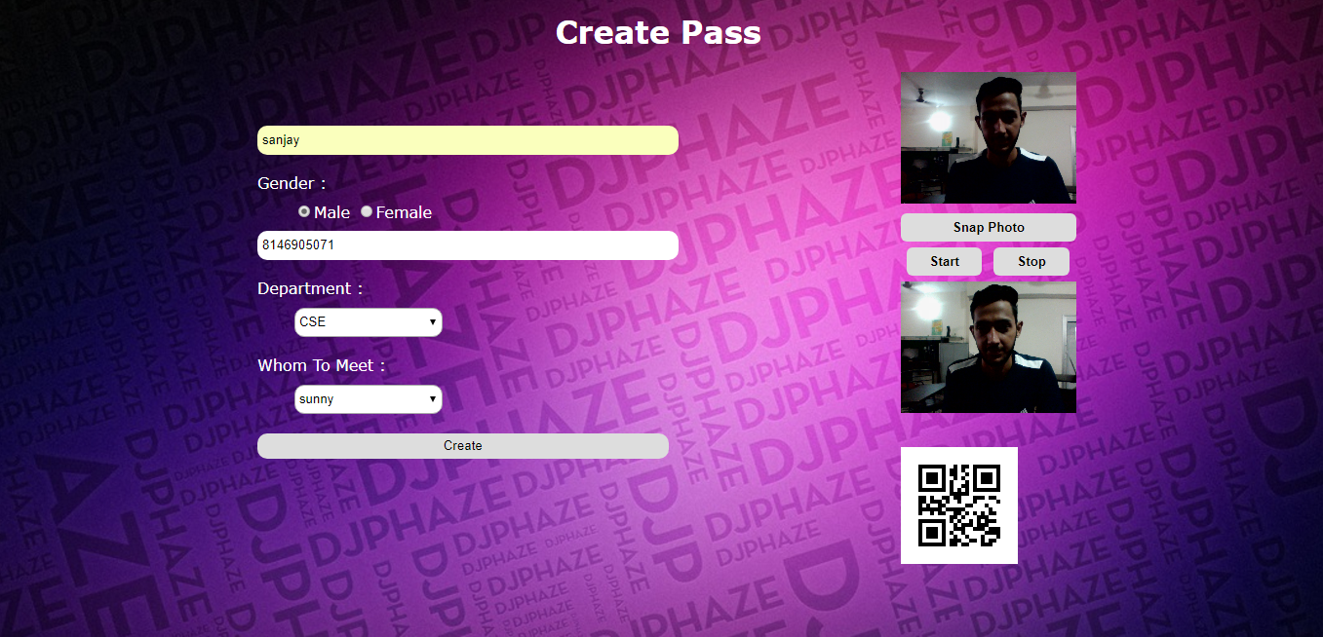
Guard Page: This page is the Guard page where Guard can do different jobs like Create pass, Check out etc.
Create Pass : This page is used for creating the pass of visitors with live capture image and QR code.

Slide 14
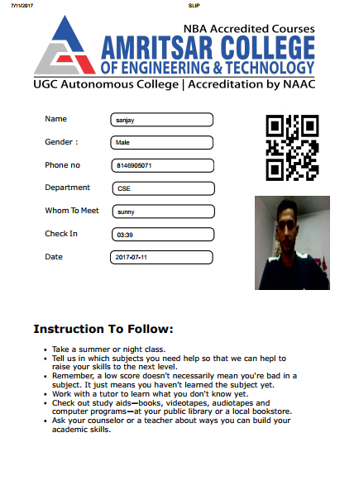
Slip : This is the slip which is generated for visitor. So guard will generates these types of slips for our visitor who visits the college.

Slide 15
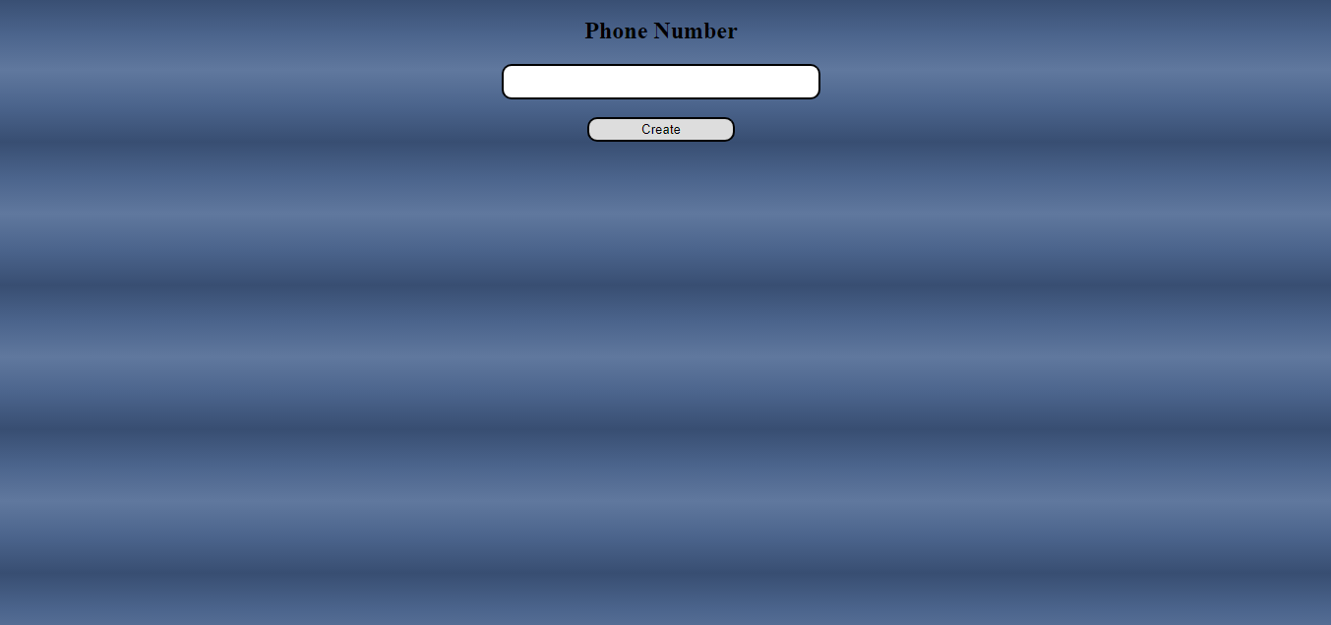
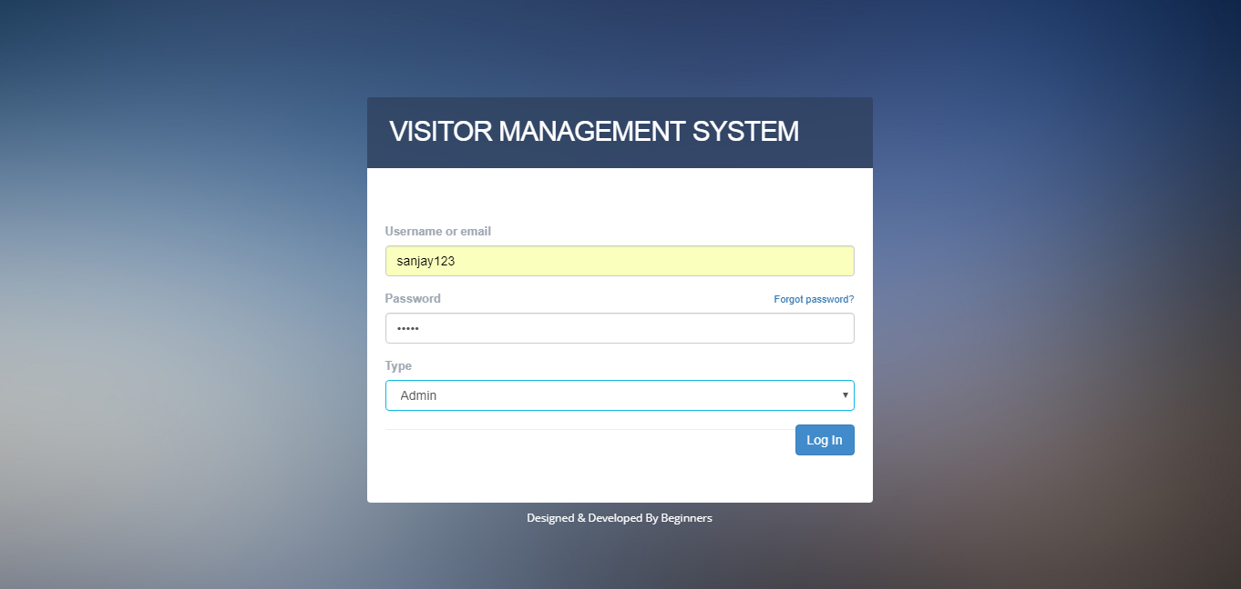
Check Out: This is the check out page for visitor. Just by enter the phone number leaving time is automatically update.
Admin Login: This page Login page for Admin by choosing the type Admin in the block which is already registered as a admin.

Slide 16
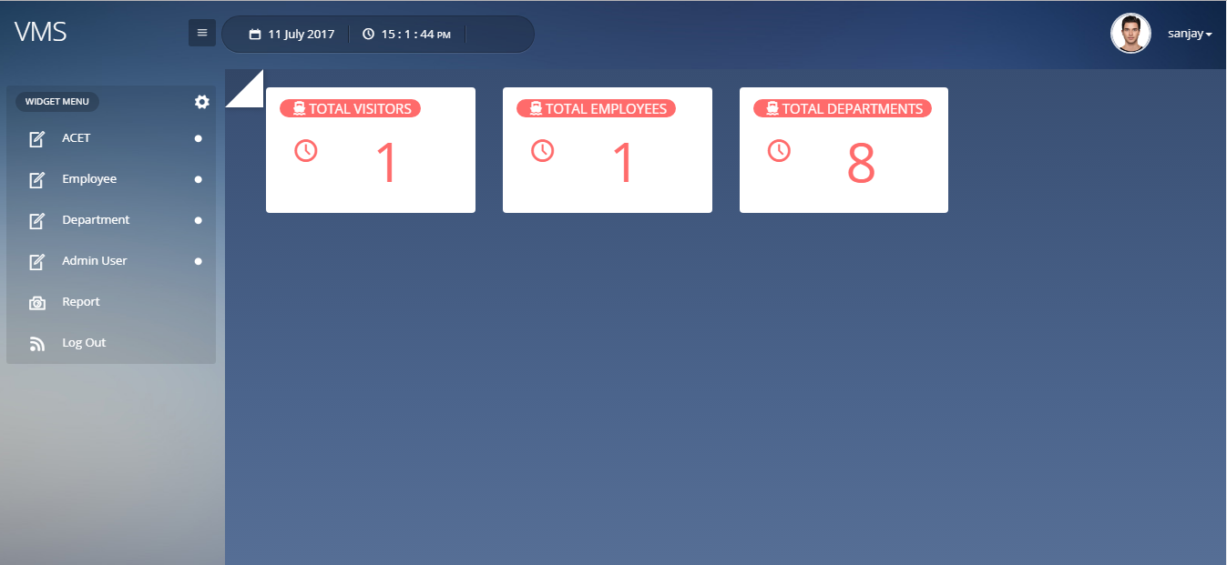
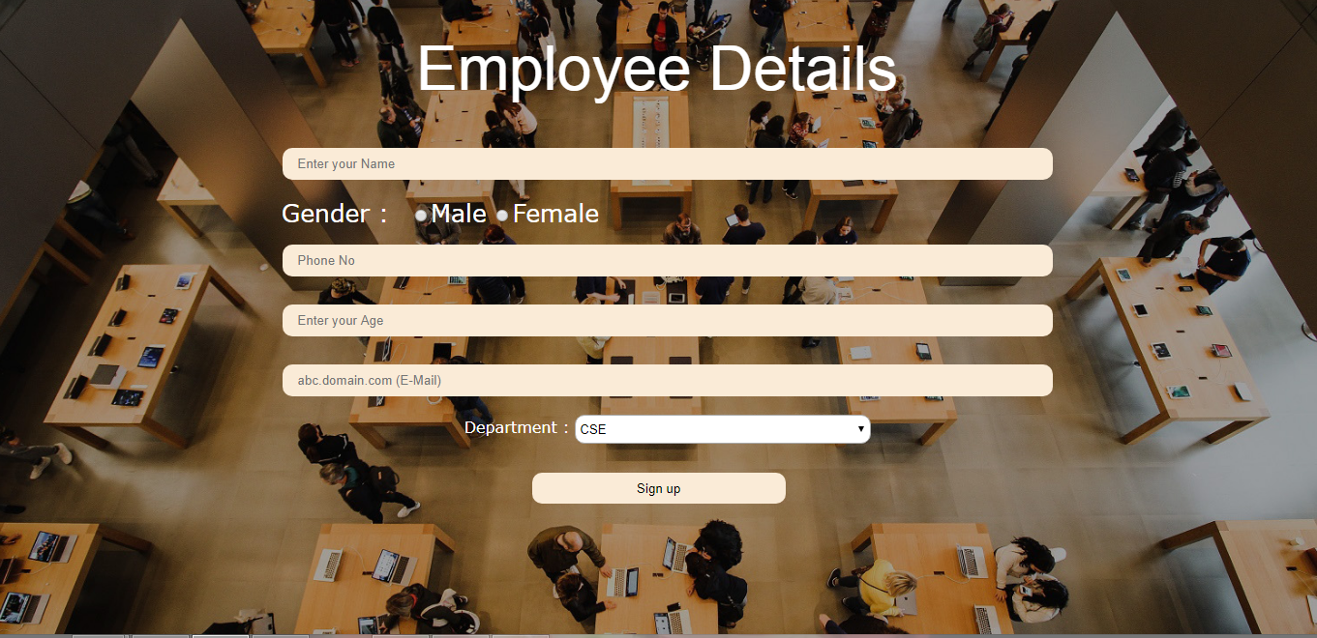
Admin Screen: This type dashboard is visible for the admin user. Where he can directly view the total visitors, total department and total employees in the college and can check employee details, visitors details and logins users.
Add Employee: This page is used to insert the employee details. By which guard can be able to send mail to the employee when the visitor visits the college.

Slide 17
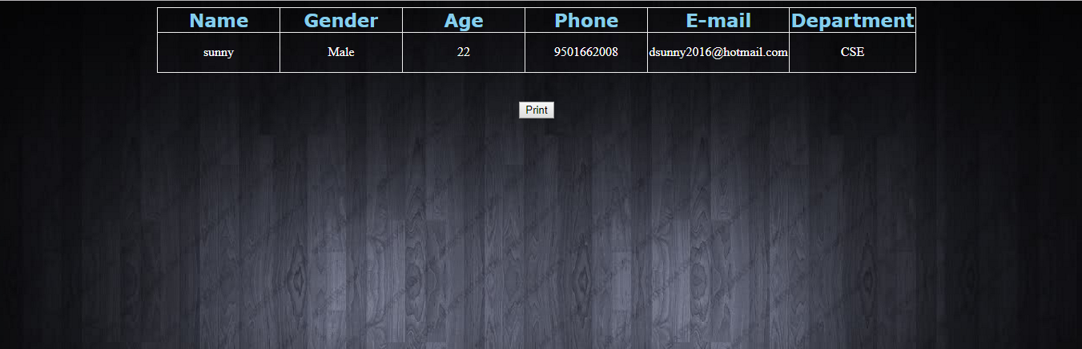
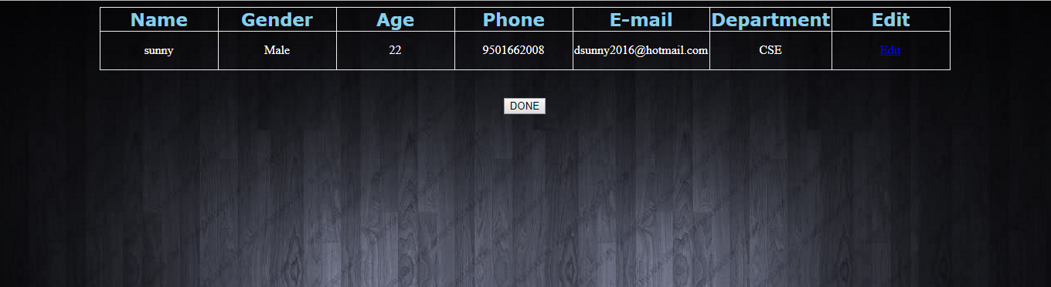
View Employee: This page will display the list of all employees in the college.
Edit Employee: In this page admin can edit the details of the employees in the college.

Slide 18
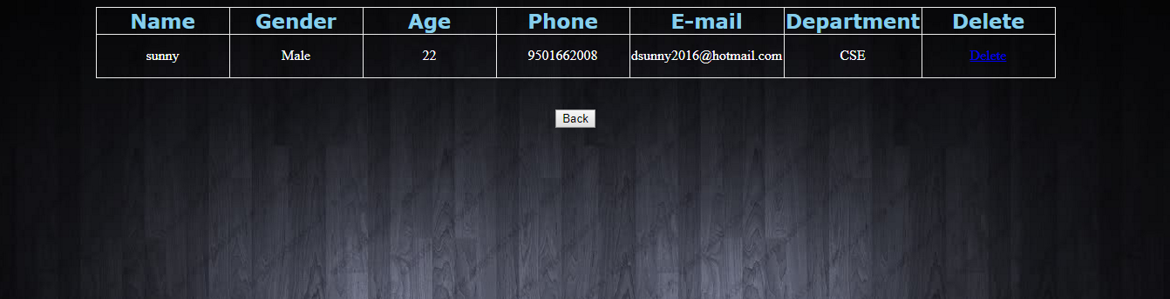
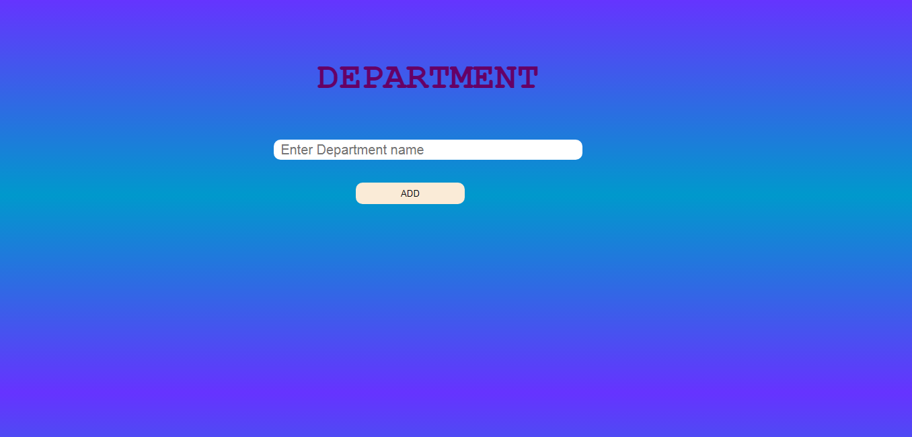
Delete Employee: In this page admin can delete the account of employees.
Insert Department: This page is used to insert the department in the database.

Slide 19
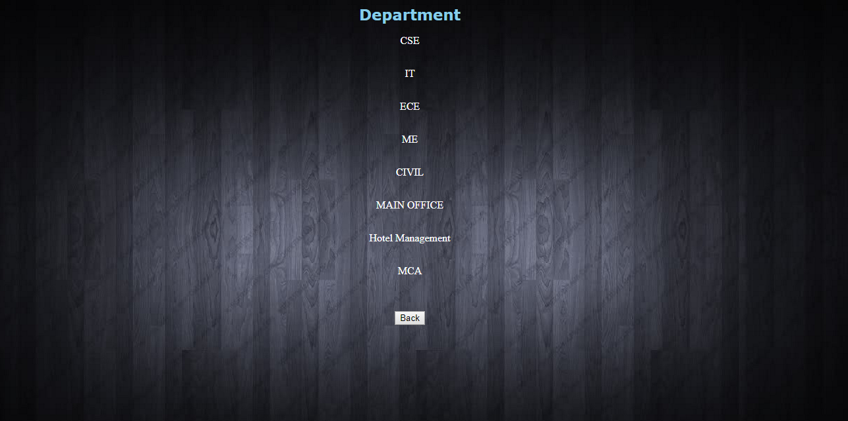
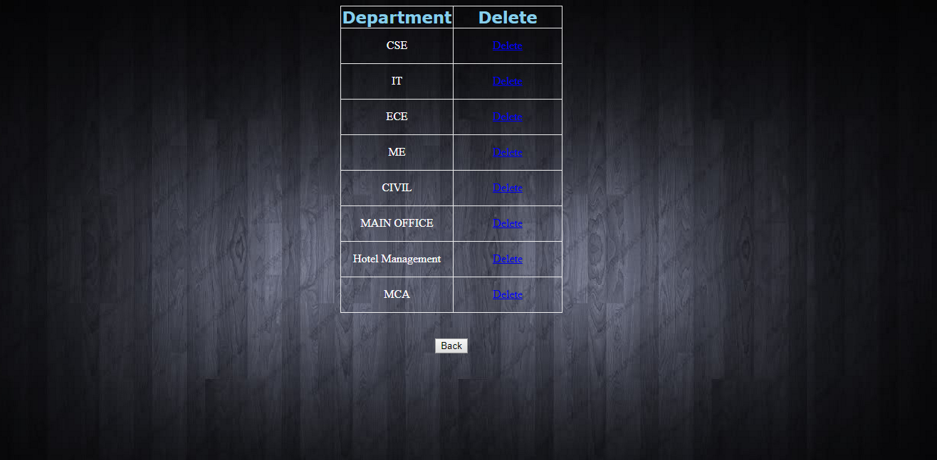
Display Department: This page display the details of all department in the college.
Delete Department: In this page admin can delete the department of the college.

Slide 20
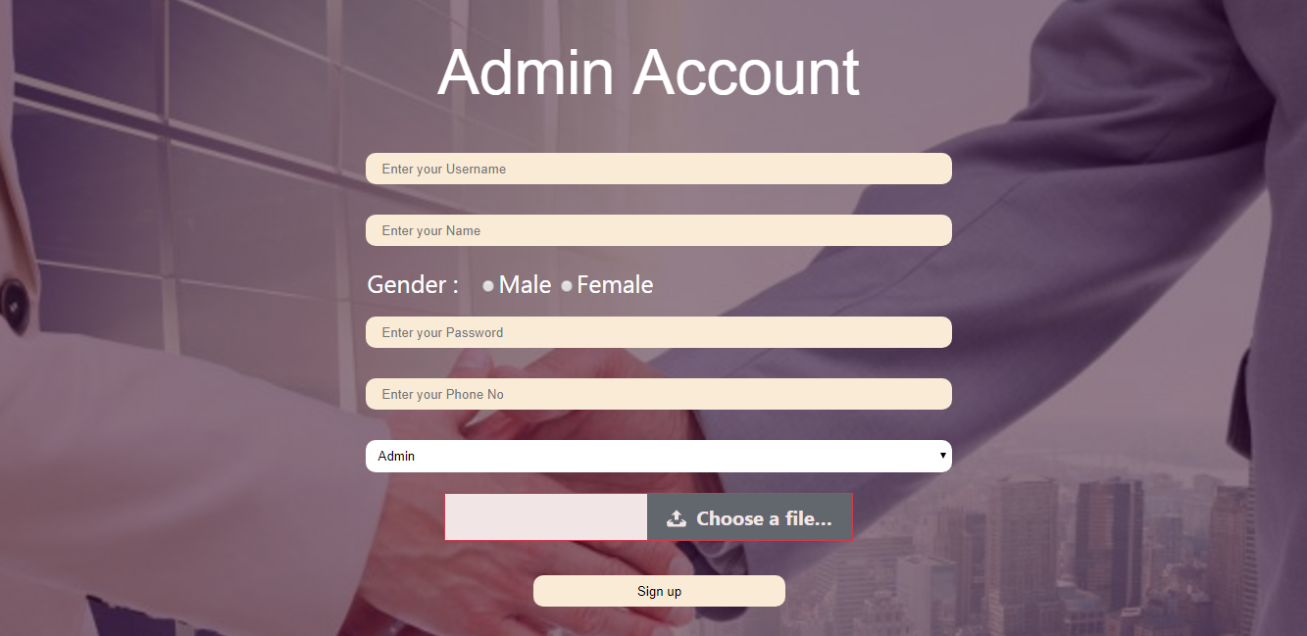
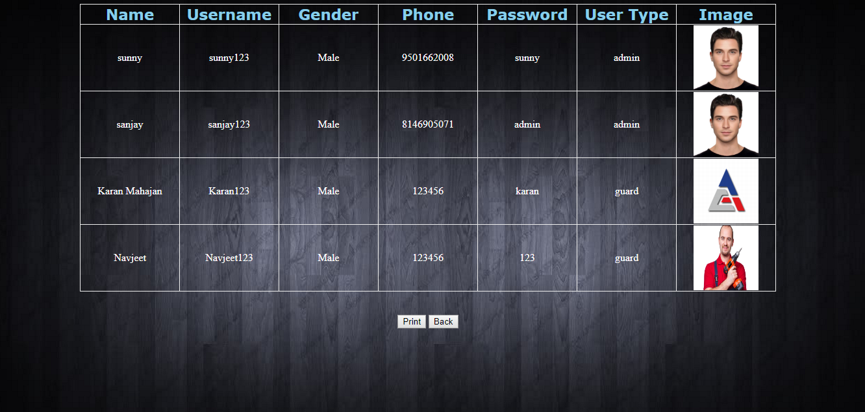
Insert Admin: We can use this page for login users. By getting an username and password guard and admin can access their account.
Display Admin User: This page will display the all account holder who access this software.

Slide 21
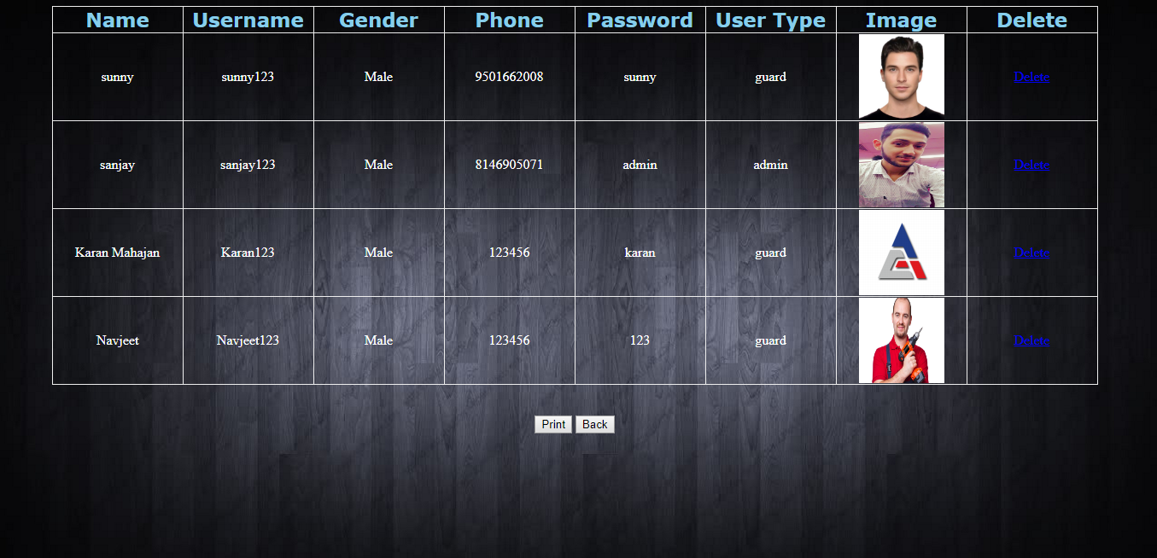

Delete Admin User: This page is used to delete the account holder. By which that account holder can’t able to access the software in future.
Check Report: This page is used for making the report of all visitors who visit the college by selecting the from date to To date.

Slide 22
Visitor Management System
Submitted to: Submitted By:
HOD(CSE) Karan Mahajan(1544657)
Navjeet Singh(1600875)
Sanjay Sharma(1544721)

Slide 23
THANK YOU

